Slide 1
Using TODWL to support unified parameterization investigations
D. Emmitt (SWA), R. Foster(UWash) and K. Godwin (LLC)
16 -18 October 2012
WG meeting in Boulder, CO

Slide 2
Outline
Science Objectives
Strategy
Status of experiments (Marina and Dugway)

Slide 3
Research goal
Contribute to the evaluation and development of the Eddy Diffusivity Mass Flux (EDMF) parameterization by using both existing and new data from the Navy Postgraduate School’s Twin Otter Doppler Wind Lidar (TODWL) in an investigation of lower tropospheric dynamics within the interaction zone of complex terrain and the coastal waters, especially in the presence of Organized Large Eddies (OLEs)and Low Level Jets (LLJs).

Slide 4
Additional goals
Determine the angle between the rolls and the mean wind. Which mean wind?
Investigate the apparent “integration” effects of the aerosols that persist without correlated velocity structures.

Slide 5
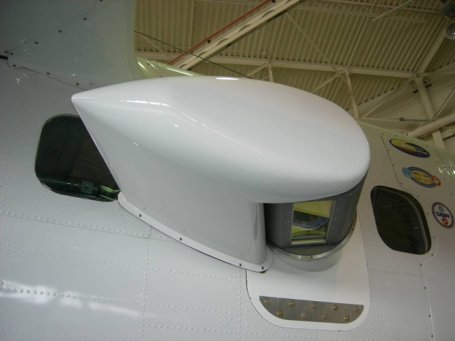
TODWL

Slide 6
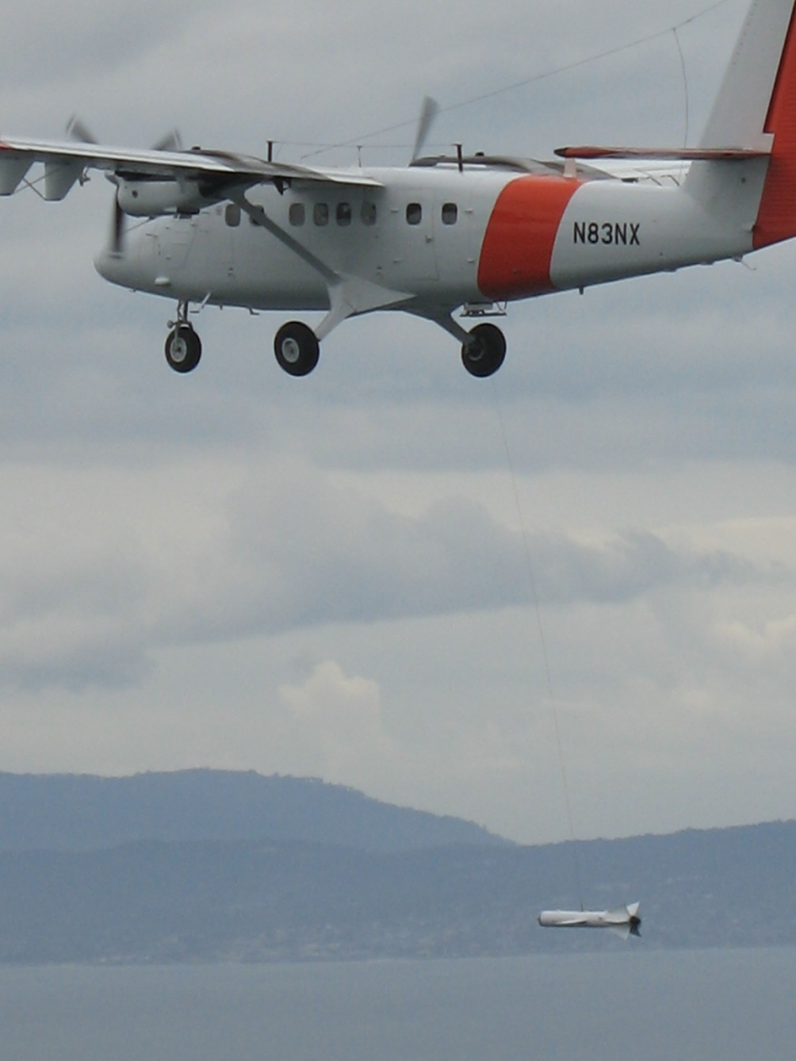
CIRPAS Twin Otter
with
CTV below

Slide 7
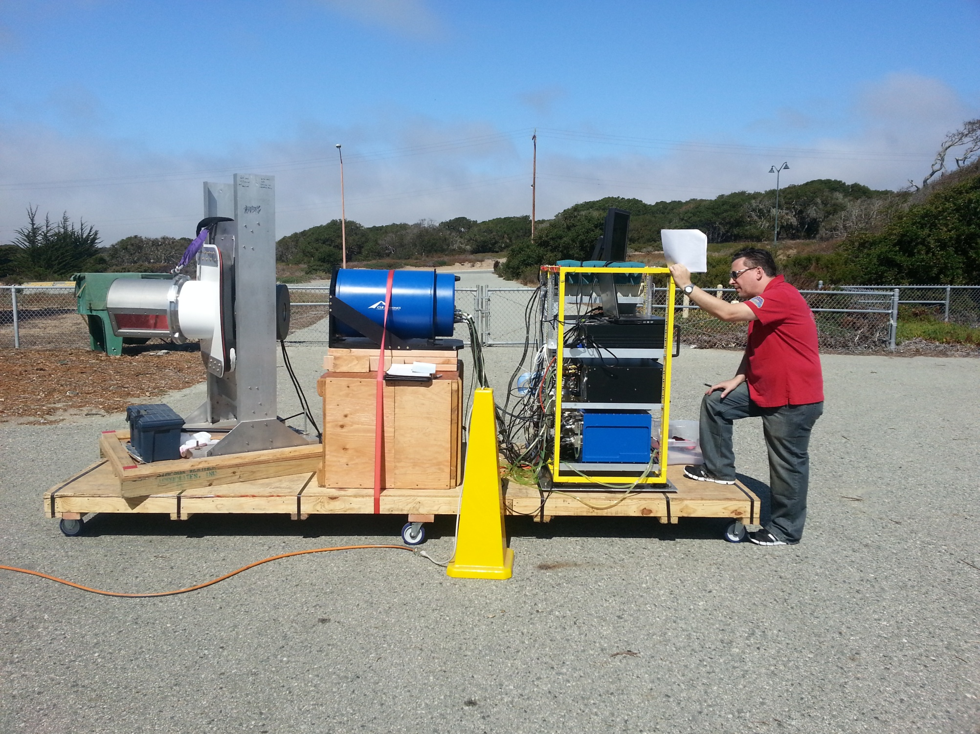
Pallet Wind Observing Lidar Facility (PWOLF)
Picture of towed TODWL

Slide 10
Coastal studies (land)
Ridge and valley circulations
Model validation
Nocturnal boundary layers
Low-level-jets (LLJ)
Organized Large Eddies

Slide 11
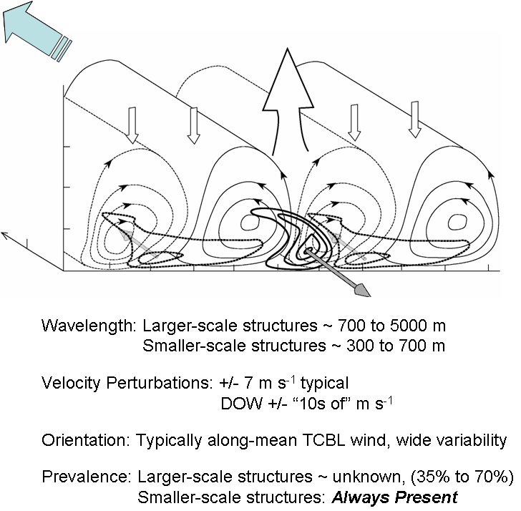

Slide 12
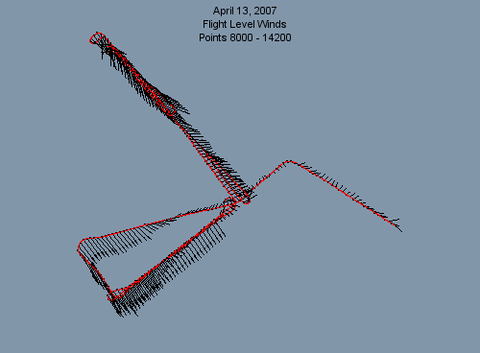
April 13, 2007 flights with CTV

Slide 13
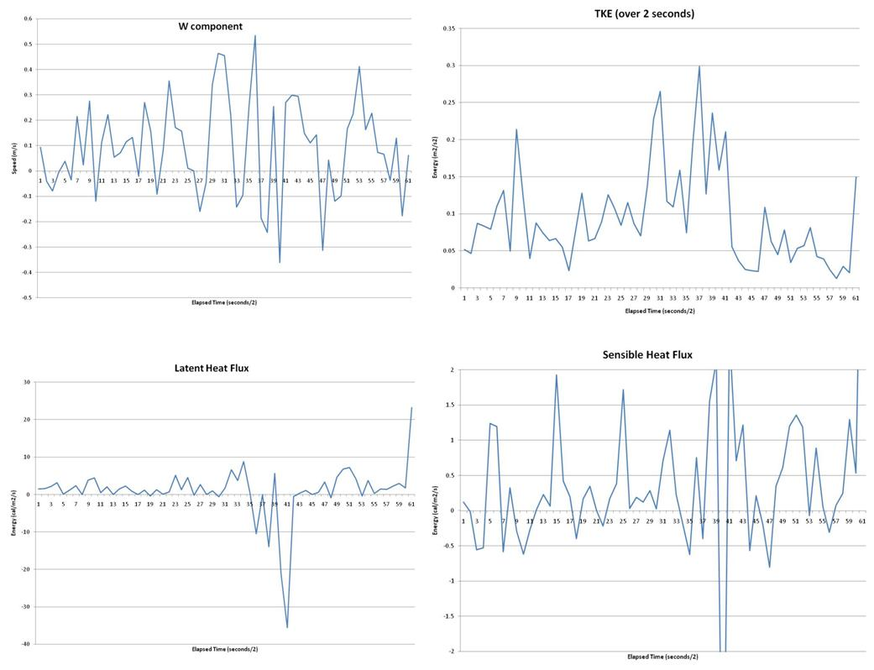

Slide 14
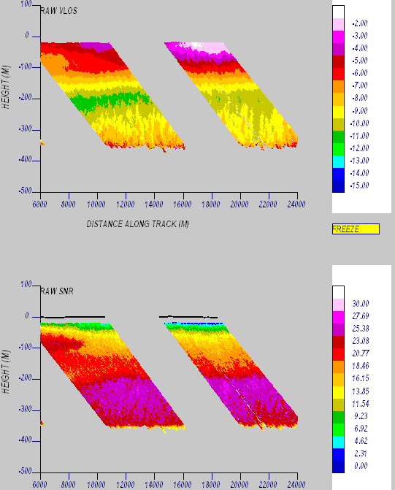
SE

Slide 15
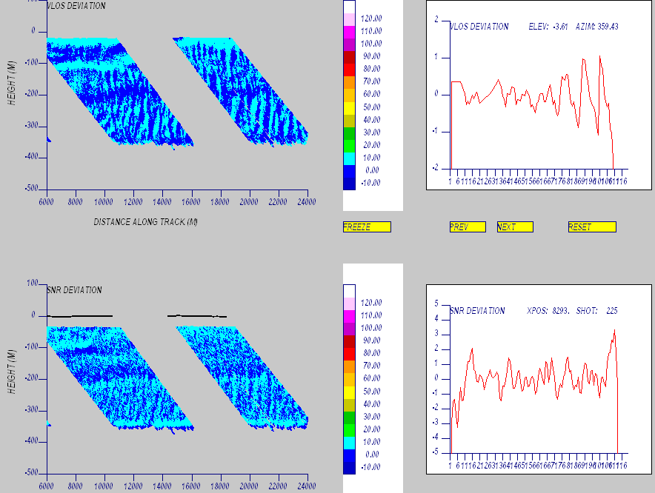

Slide 16
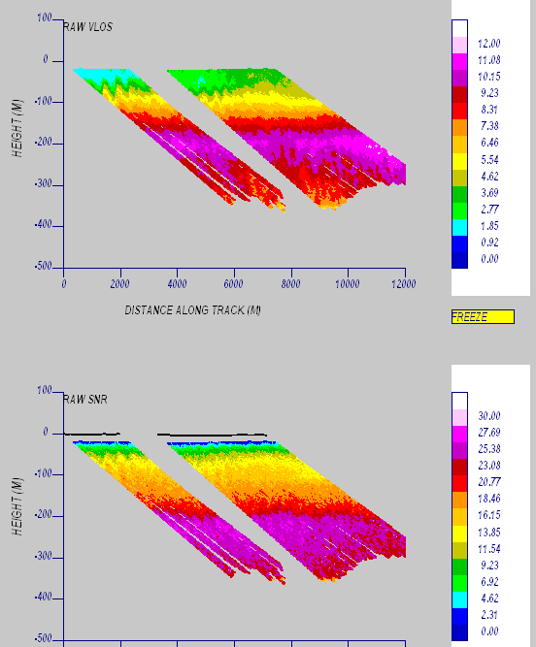
NW

Slide 17
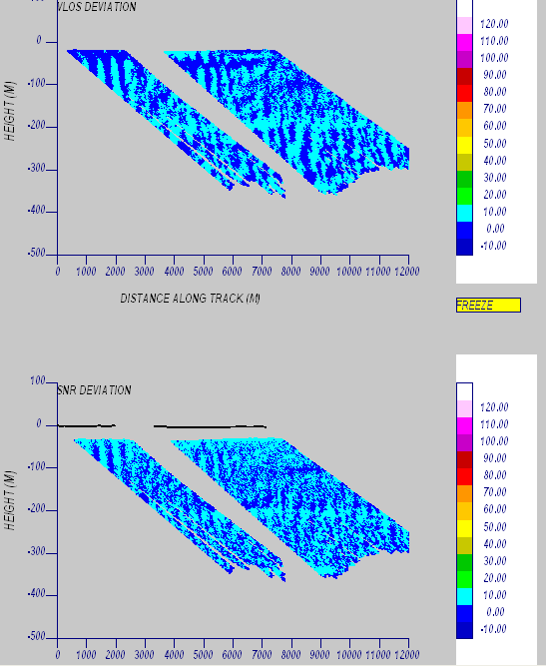

Slide 19
Summary
One good Salinas Valley mission
One good off shore aerosol street case.
CTV flown at different levels in the MBL
Final processing data in progress.

